Slide 1
Secure Email Service in Cloud by using Modified Homomorphic Encryption
SAI KRISHNA JETTI
HTNO:2316188

Slide 2
INDEX
Introduction
Aim
Existing System
Proposed System
Entity-relationship Diagrams
Data Dictionary
Design Algorithm
Modules
Test Case Design
Screens
Conclusion

Slide 3
INTRODUCTION
The main aim of the project “Secure Email Service in Cloud by using Modified Homomorphic Encryption” is to provide security in email service through the Cloud

Slide 4
AIM
The main aim of the project is to develop Security based email service in Cloud Computing. A good problem definition identifies the problem clearly, not an imposed solutions to the problem.

Slide 5
Existing System
If emails aren’t encrypted, sending confidential data is like telling hackers “please, come steal our information.” We don’t want that to happen to any business, but it happens all too often.

Slide 6
Proposed System
The primary purpose of encryption is to protect the confidentiality of digital data stored on computer systems or transmitted via the internet or any other computer network. Developed this project I am using a modified encryption algorithm.

Slide 7
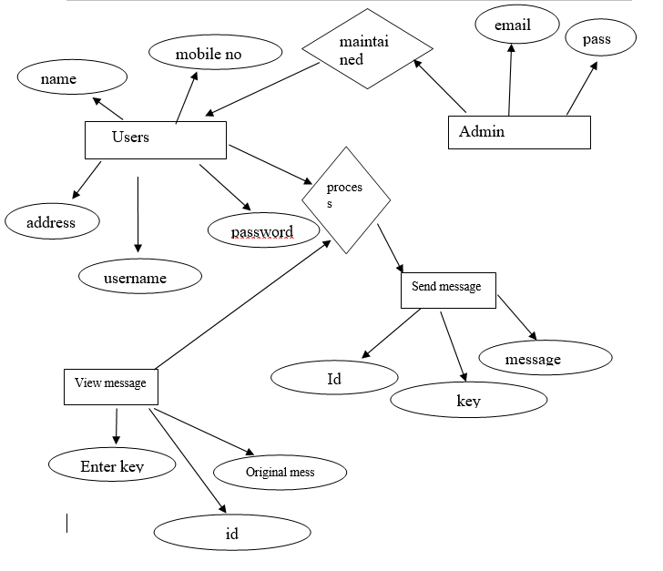
Entity-Relationship Diagrams
ER DIAGRAM

Slide 8
Data Dictionary
A Data dictionary as the name implies, is a repository of information about data. In some database systems, the stored definitions of data (called schemas) provide all necessary data dictionary information

Slide 9
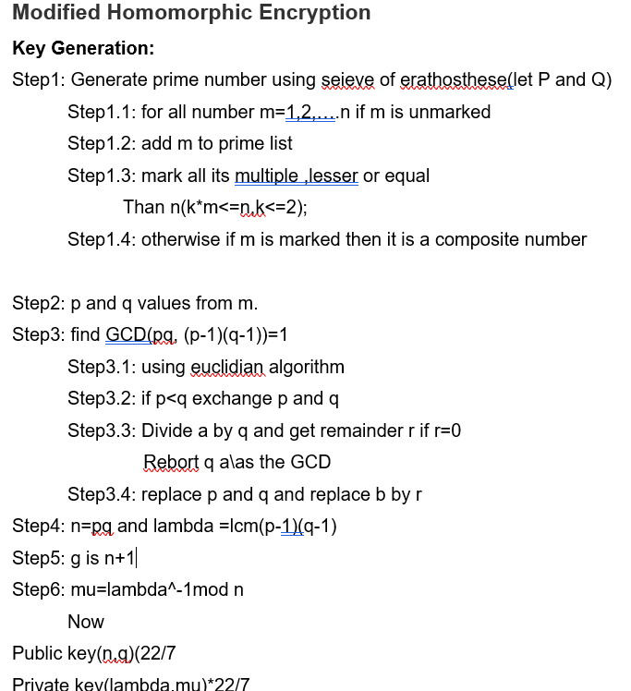
Design Algorithm

Slide 10
mODULES
The project following modules
User Details Module
User Selection Module
Send/View module

Slide 11
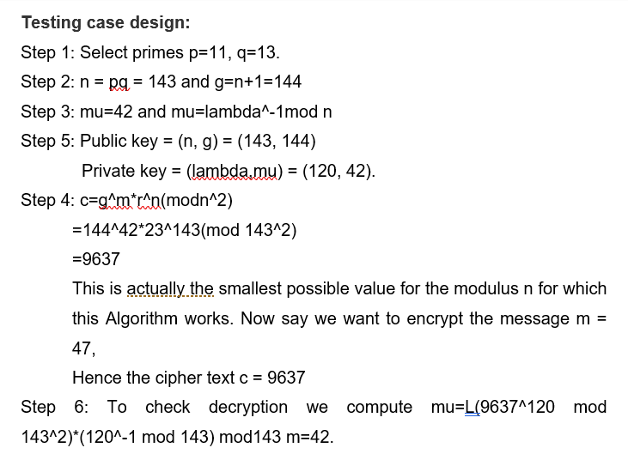
Testing case design:

Slide 12
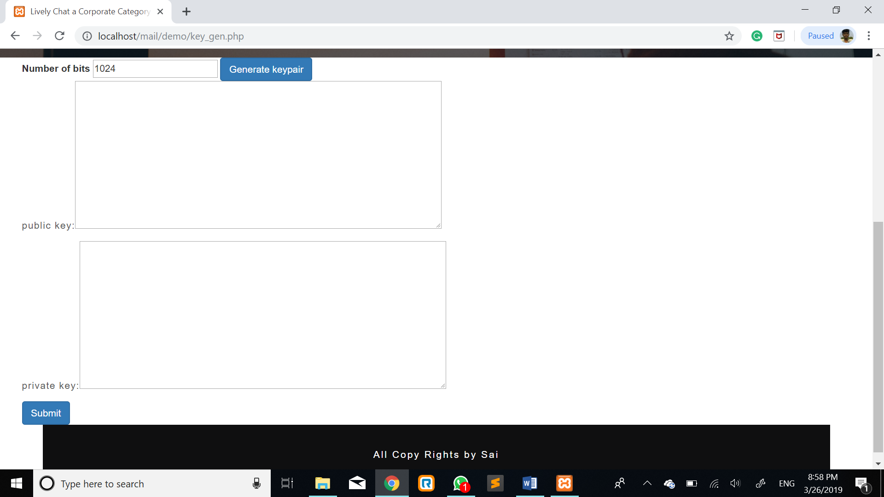
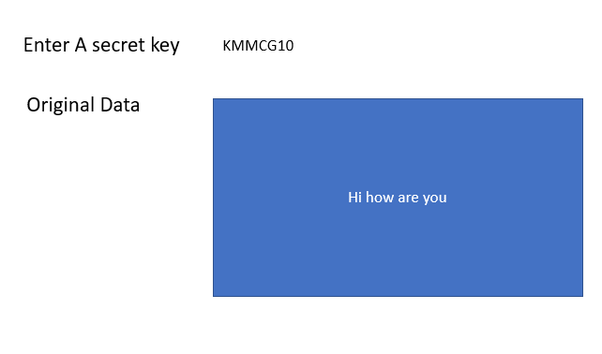
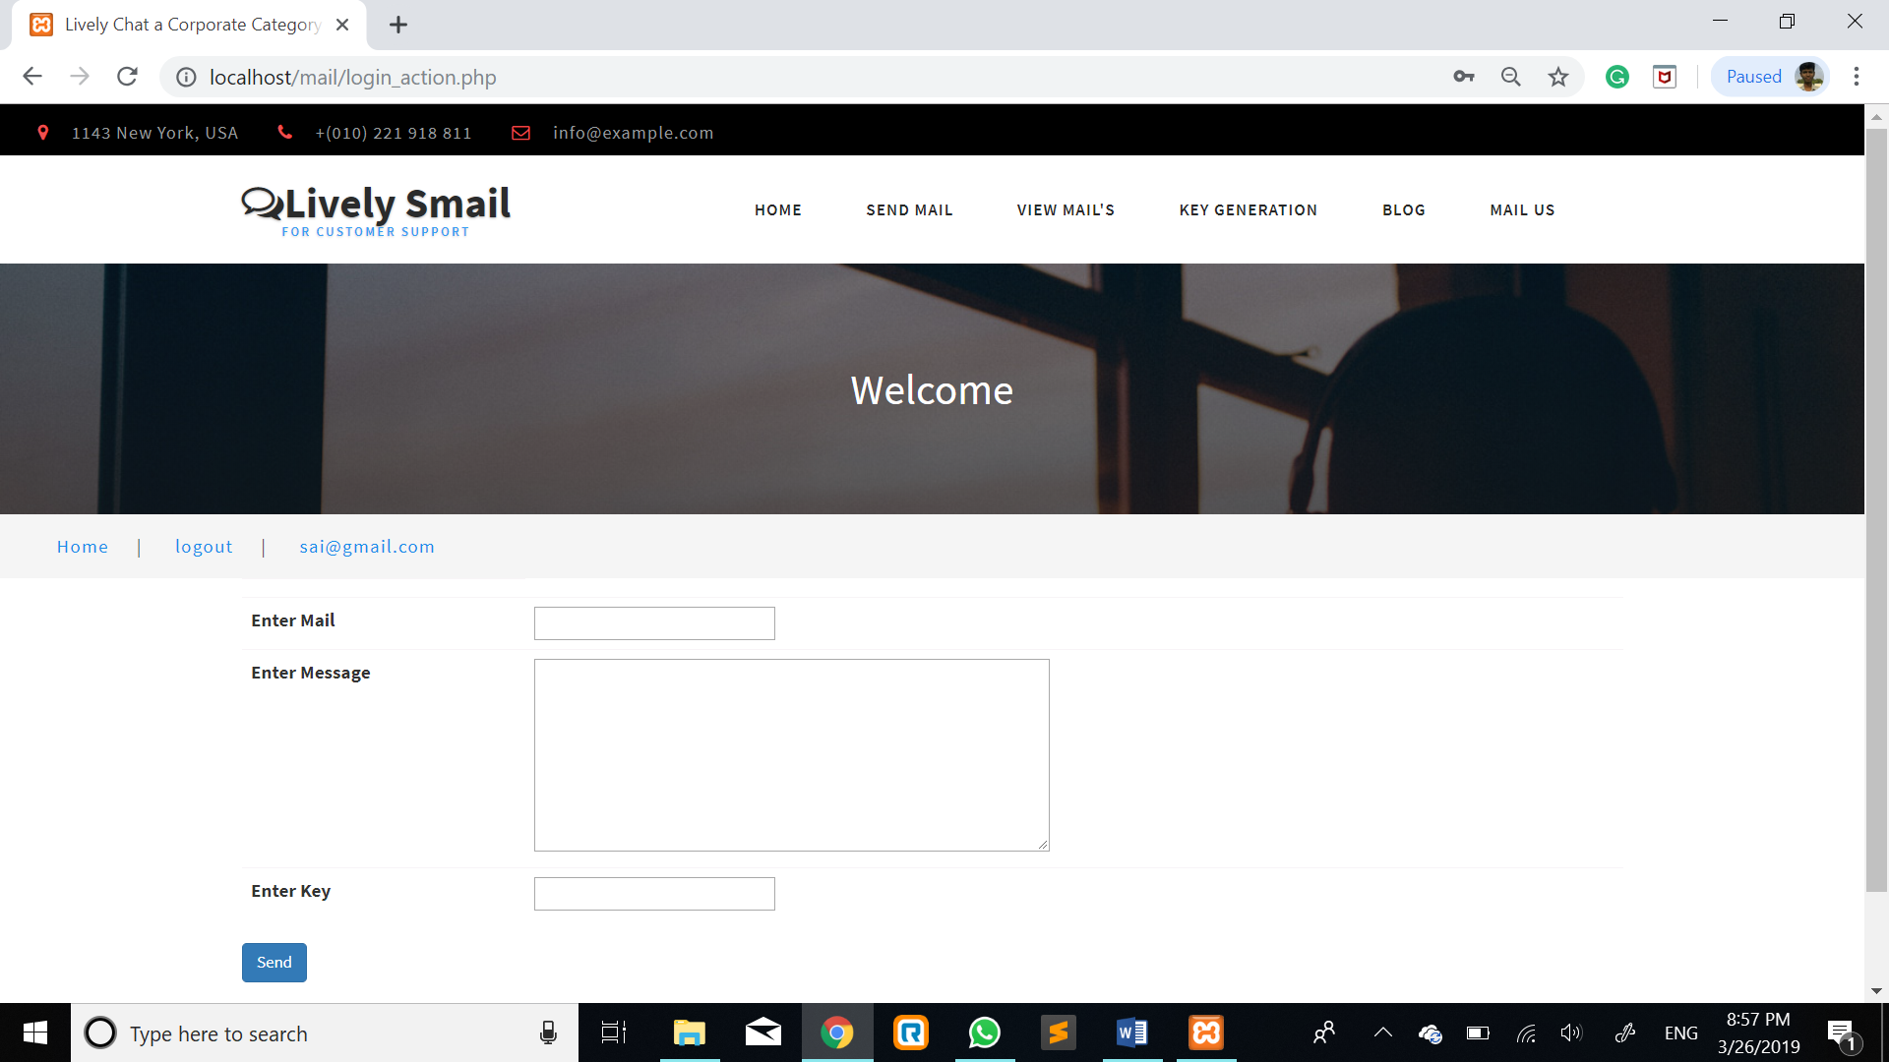
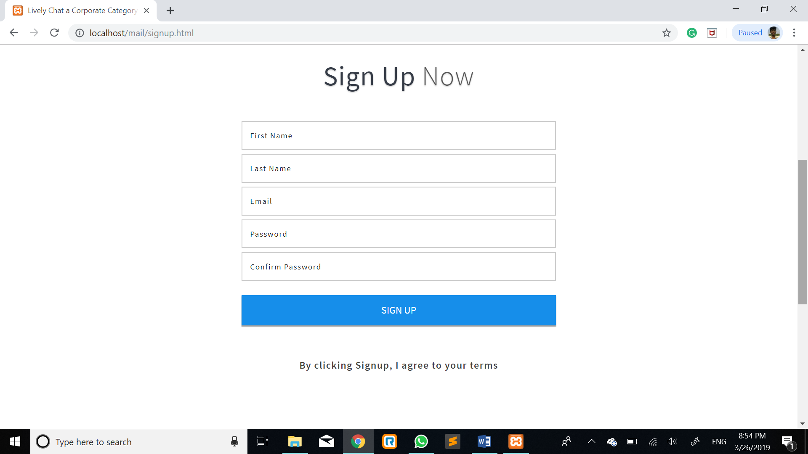
Some screens

Slide 13
conclusion
The Modified homomorphic encryption algorithm we used in this project for that we can get security in cloud email service. We can do encryption by using a public key when the time send email meanwhile we can do decryption by using a private key when the time views the email in the cloud.

Slide 14
Quires ?

Slide 15
Thanking you

